Slide 1
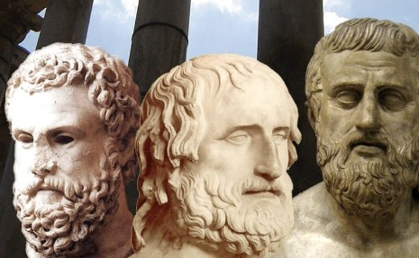
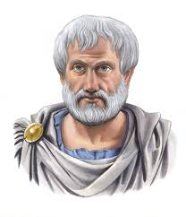
Overview of Greek Theatre
The land
The Playwrights
The stage
Aristotle's The Poetics

Slide 2
The Land
Ancient Greeks attended theatre was one’s civic duty
Greece has thousands of inhabited islands and dramatic mountain ranges
Greece has a rich culture and history
Democracy was founded in Greece
Patriarchal (male dominated) society
Philosophy, as a practice, began in Greece (Socrates, Plato, Aristotle)

Slide 3
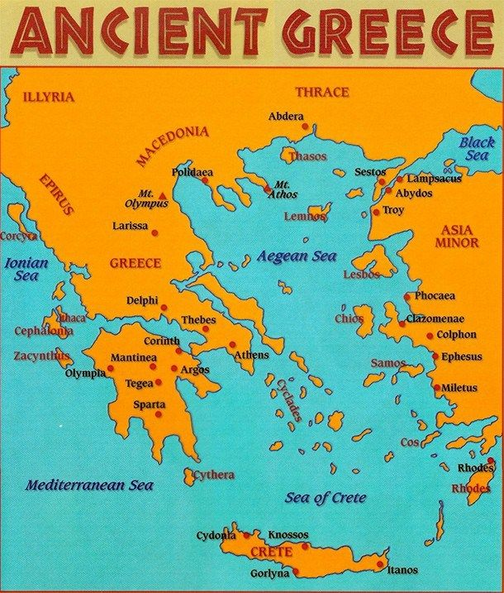
The Land
Located in Europe by the Aegean Sea

Slide 4
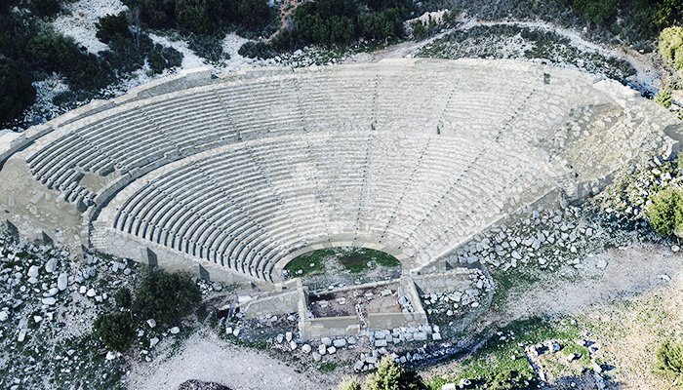
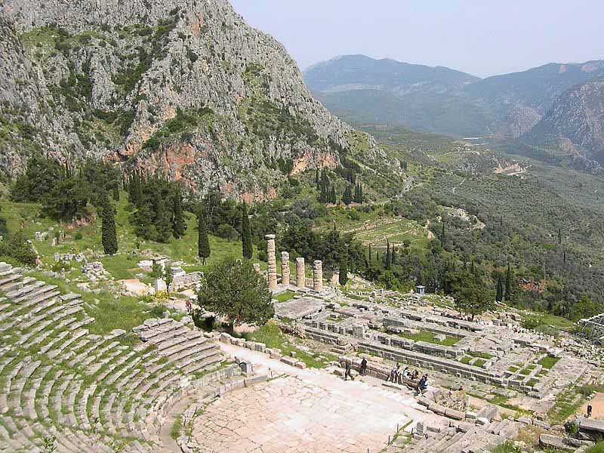
The Land

Slide 5
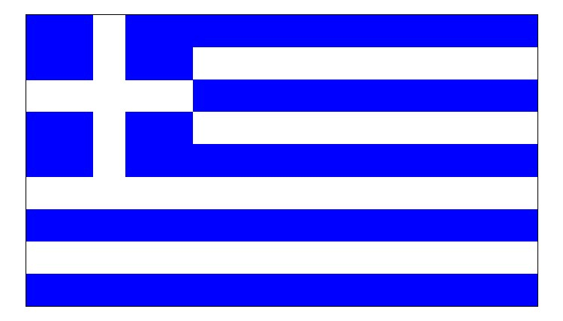
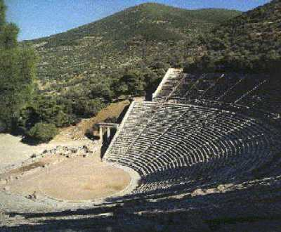
The land
The Playwrights
The Stage
Aristotle's The Poetics

Slide 6
Amphitheatre

Slide 7
Amphitheatre
Three Main Portions of Greek Theatre:
Skene – Portion of stage where actors performed (included 1-3 doors in and out)
Orchestra – “Dancing Place” where chorus sang to the audience
Theatron – “The Seeing Place” Seating for audience

Slide 8
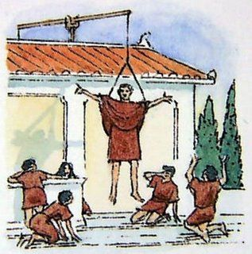
Ancient Stagecraft
Deus Ex Machina - translated as "God out of the machine," refers to the theatrical machine known as machene,
which “A mechanical device that permitted an actor, playing a god, to resolve complex dramatic situations. “

Slide 9
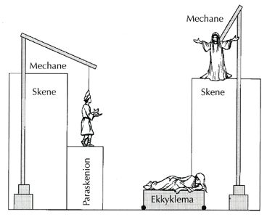
Ekkyklema
Wheeled cart to move set pieces on and off the acting area

Slide 10
Amphitheatre
Thymele
Proscenium Arch
Skene
Orchestra
Theatron

Slide 11
From Song to Plays
Greek plays were performed during religious ceremonies held in honor of Dionysus, the Greek god of wine and revelry (altars generally on stage)
Greek invented/formalized three forms of theatre, first Tragedy developed from stories told in choir songs called a Dithyramb, Satyr plays short plays for intermission during Tragedy, and last Comedies
Tragedy means “goat song” (relates to Dionysian rituals)

Slide 12
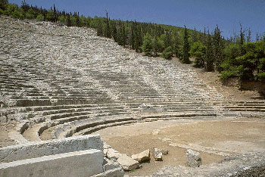
Where and how were the dramas performed?
…In an Amphitheatre
…With a chorus who
Commented on the action.
Provided spectacle by singing and dancing.
Played the role of community in the world of the play
…With masks
…With all the fighting and movement going on off stage. ….With tragedy first, then comedy later.

Slide 13
The Dying and Rising God. Because crops die in winter and return in spring, Dionysus was seen as a symbol of death and resurrection. In another story about his birth, Dionysus was the son of Zeus and Demeter, the goddess of crops and vegetation. Hera was jealous of the child and convinced the Titans to destroy him. Although Dionysus was disguised as a baby goat, the Titans found him, caught him, and tore him to pieces. They ate all of his body except his heart, which was rescued by Athena *. She gave the heart to Zeus, who gave it to Semele to eat. Semele later gave birth to Dionysus again. The story represents the earth (Demeter) and sky (Zeus) giving birth to the crops (Dionysus), which die each winter and are reborn again in the spring.

Slide 14
Dionysia had festivals throughout the farming and harvesting seasons of Grapes. Three months after the rural Dionysia, probably to celebrate the end of winter and the harvesting of the year's crops of grapes and give time to make the years harvest into wine in late spring The City of Dionysia festival was held.
According to tradition, a statue of Dionysus was brought to Athens.

Slide 15
As the Statue of Dionysus was brought in, the Chorus leaders would be in the most expensive costumes and leading the chorus to sing a Dithyramb, (Hymns and songs that retold famous stories and myths)

Slide 16
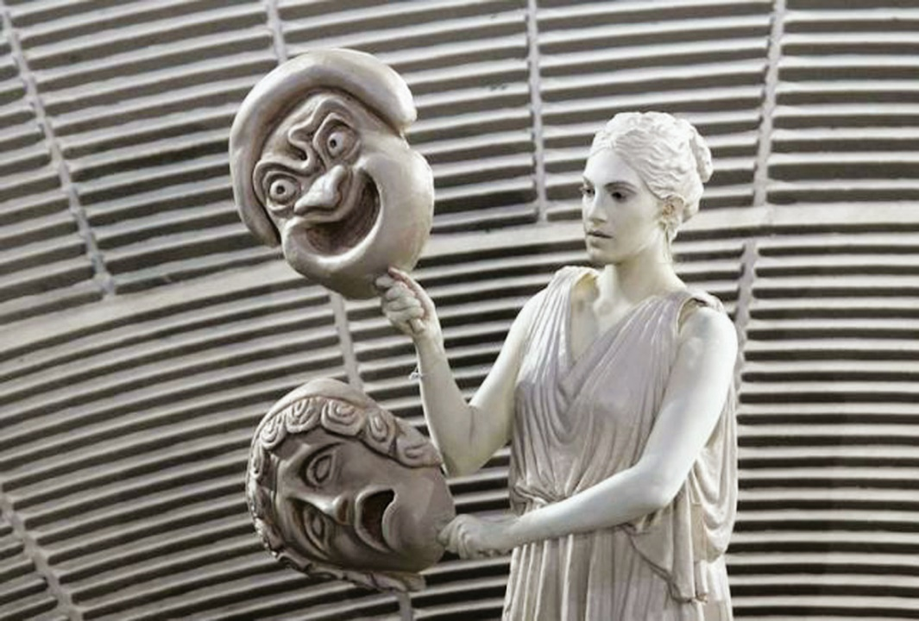
In Ancient Greece, attending the theatre was seen as One’s civic duty.
Winners of the Greek Theatre Festivals won the Tragoidia, which could roughly translates to Goat Song.

Slide 17
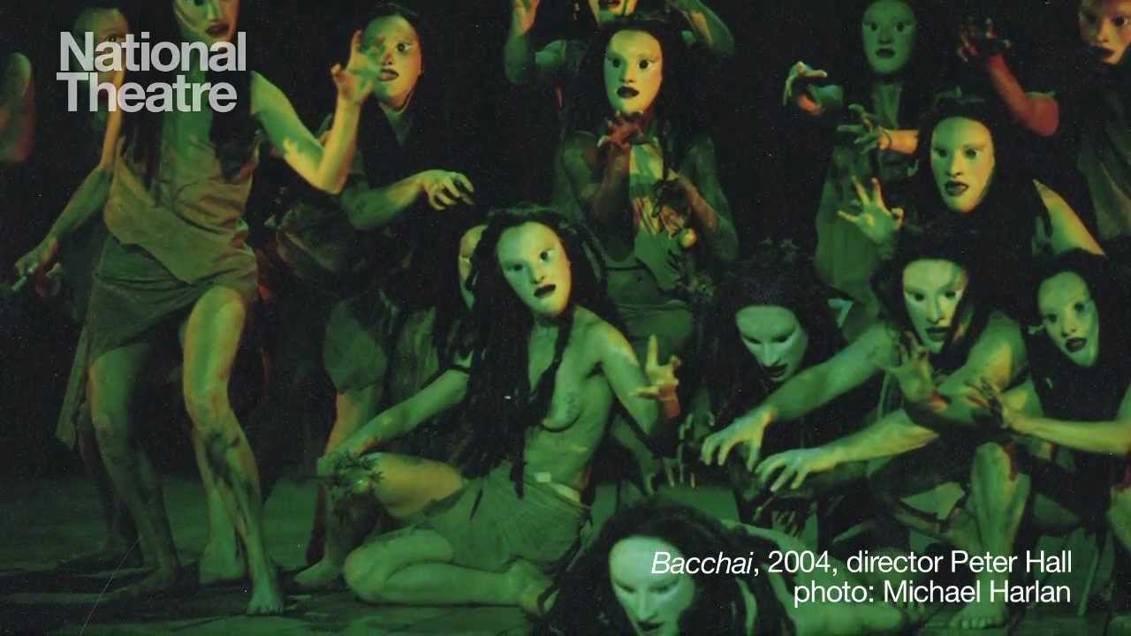
In the beginning large chorus of 50 men would sing a type of song called a Dithyramb

Slide 18
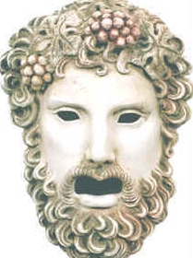
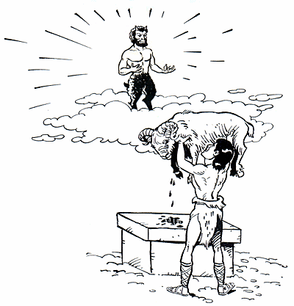
Chorus
To commemorate the god’s death, a group of 50 chanters, called the chorus, dancing around an alter upon which a goat was sacrificed.

Slide 19
The land
The Playwrights & Actors
The Stage
Aristotle's The Poetics

Slide 20
The First Actor
Thespis was the first actor in Greek drama. He was often called the inventor of tragedy, and his name was recorded as the first to stage a tragedy at the Great Dionysia Festival (c. 534 bc).

Slide 21
Major Greek Playwrights
Aeschylus | Tragedy | Seven Against Thebes
Sophocles | Tragedy | Antigone Oedipus
Euripides | Tragedy | Medea
Aristophanes | Comedy | Lysistrata

Slide 22
Aeschylus
Known as the Father of Tragedies
According to Aristotle, he expanded the number of characters in theater allowing conflict among them; characters previously had interacted only with the chorus.

Slide 23
Sophocles
Theban plays
The Theban plays consist of three plays: Oedipus the King, Oedipus at Colonus and Antigone. All three plays concern the fate of Thebes during and after the reign of King Oedipus. However, wrote the three plays for separate festival competitions, many years apart.

Slide 24
Euripides’ Medea
Contributions of Euripides: Where Aeschylus and Sophocles emphasized plot, by adding an actor each, Euripides added intrigue. Intrigue is complicated in Greek tragedy by the constant presence of the all-knowing chorus.
Euripides also created the love-drama. New Comedy took over the more effective parts of Euripides' technique. In a modern performance of Euripides' tragedy, Helen, the director explained it was essential for the audience to see immediately that it's a comedy.

Slide 25
Aristophanes
Wrote the comedy Lysistrata
Also known as "The Father of Comedy" and "the Prince of Ancient Comedy"
His powers of ridicule were feared and acknowledged by influential contemporaries; Plato singled out Aristophanes' play The Clouds as slander that contributed to the trial and subsequent condemning to death of Socrates, although other satirical playwrights had also caricatured the philosopher.

Slide 26
The land
The Playwrights
The Stage
Aristotle's The Poetics

Slide 27
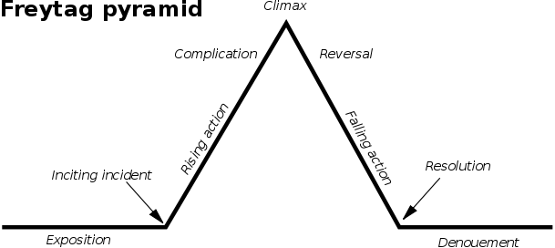

Slide 28
complication
unravelling

Slide 29
Important terms from Aristotle's The Poetics
Tragedy - serious drama featuring a noble dignified character-often a member of royalty-who strives to achieve something and is ultimately defeated
Tragic flaw - character flaw or weakness that results in the character's downfall (usually pride/hubris)
Tragic hero - A character, usually of high birth, neither totally good nor totally evil, whose downfall is brought about by some weakness or error in judgement

Slide 31
Hamartia - A tragic flaw, weakness of character or error in judgement that causes downfall in hero
Hubris - Arrogance or overreaching pride which causes hero's transgression against gods; usually tragic flaw
Peripetia - A reversal of fortune

Slide 32
Nemesis - Fate that cannot be escaped (Antigone)
Catharsis - Purgation of emotions of pity and fear which leaves the viewer both relieved and elated
Anagnorisis - recognition or discovery on the part of the hero; change from ignorance to knowledge

Slide 33
The structure of Greek tragedy is characterized by
a prologue
then Parodos or entrance of the choirs
Next the story unfolds through three or more episodes
scattered by the stasima, choral song explaining or commenting on the situation developing in the play
The tragedy ends with the exodus, concluding the story.

